Slide 1
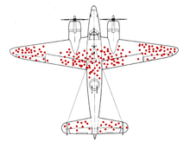

Slide 2

Notes:
##survivors bias
<img src = "images/survivors_bias.png">

